Slide 1
3D Image Segmentation and Quantification of Lysosomes
29/12/2025

Slide 2
SCRIPT LOGIC
You have a bright spot (a blob) in a 3D image, and you want to estimate how big it is, then instead of guessing the size from the detection algorithm, the code measures how brightness changes as you move away from the blob’s center.
The code groups all voxels that are about the same distance from the center (like thin spherical shells) and averages their brightness.

Slide 3
HOW ARE PEAKS AND DIAMETERS OBTAINED?
You already have “blobs” detected (center + an initial radius in pixels, usually from a distance-transform / blob detector). This function refines the radius by measuring how the image intensity changes as a function of distance from the blob center (a radial intensity profile), then estimating a radius using a half-maximum width (FWHM-style) rule.
Two main methods:
Radial intensity profile
Full width at half maximum(FWHM)

Slide 4

Radial intensity profile
It works as a size estimator that groups voxels into spherical layers and calculates the approximate average of the expected I(r).
That produces a curve:
I(r) = average brightness at distance r
So it becomes a 1D problem: one curve instead of a full 3D shape.
“At a distance “r” from the center “Xo”, take all the pixels/voxels that are exactly that far away, and average their brightness.”

Slide 5
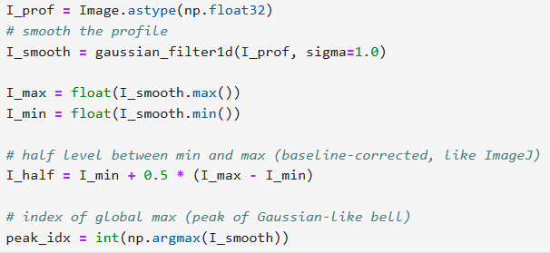
FWHM
It is a classic way to measure the “width” of a peak, used heavily when the shape is Gaussian-like.
In microscopy, many bright-blob appearances are shaped by the point spread function (PSF); a Gaussian is a common approximation.
So the half-maximum width is directly linked to the spread parameter.
Your implementation measures the half-maximum extent in radius and uses it as a diameter proxy.
It is a single integer index and refers to the position where I_smooth is largest.
Example:
If I_smooth = [2, 5, 9, 7], then np.argmax(I_smooth) is 2 (the value 9 is at index 2).
That index later maps to a radius via r_prof[peak_idx].

Slide 6
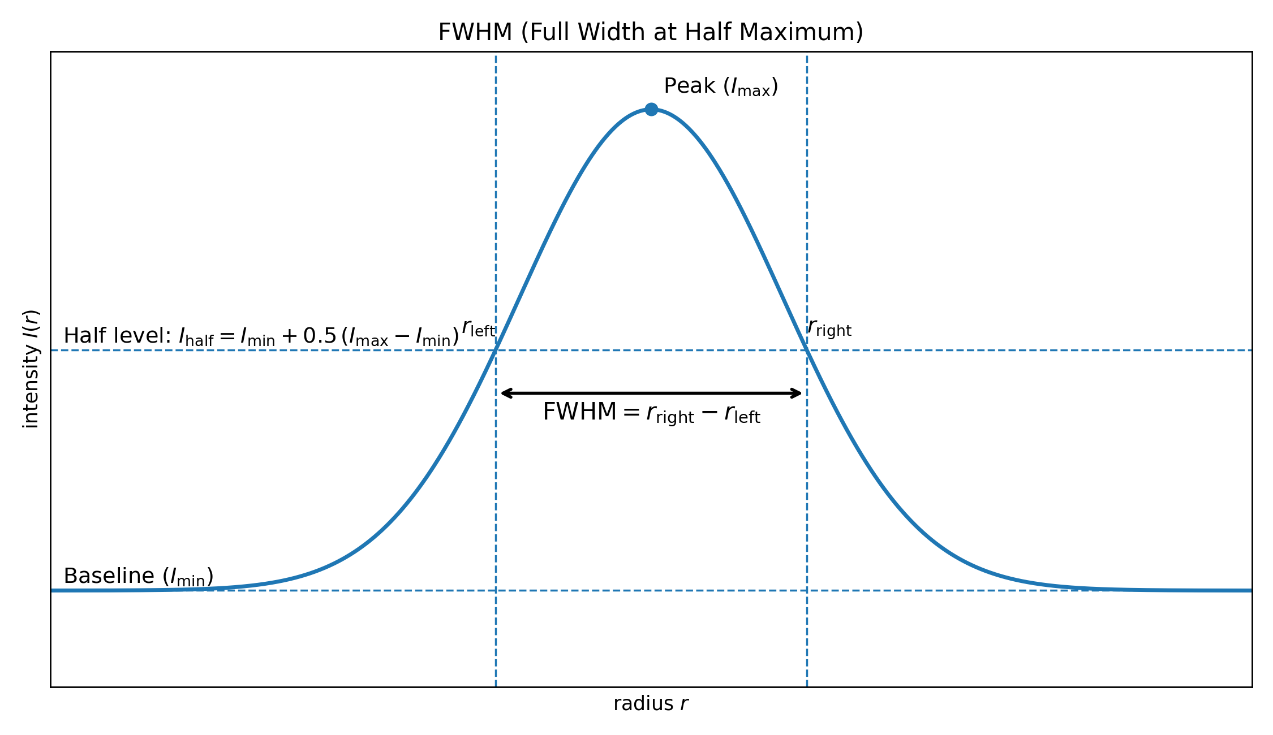
FWHM

Slide 7
SUMMARY
It estimates blob size by averaging brightness in spherical shells around the center, then taking the width of the brightness “bump” at half its height as a diameter-based radius, measured in um.

Slide 8
FILES
JULY 2024
L3_1
L3_2
L3_4
18H 1
18H 4
DECEMBER 2022
0h_1
0h_2
4h_1
4h_2
8h_1
8h_2

Slide 9
DECEMBER 2022

Slide 10
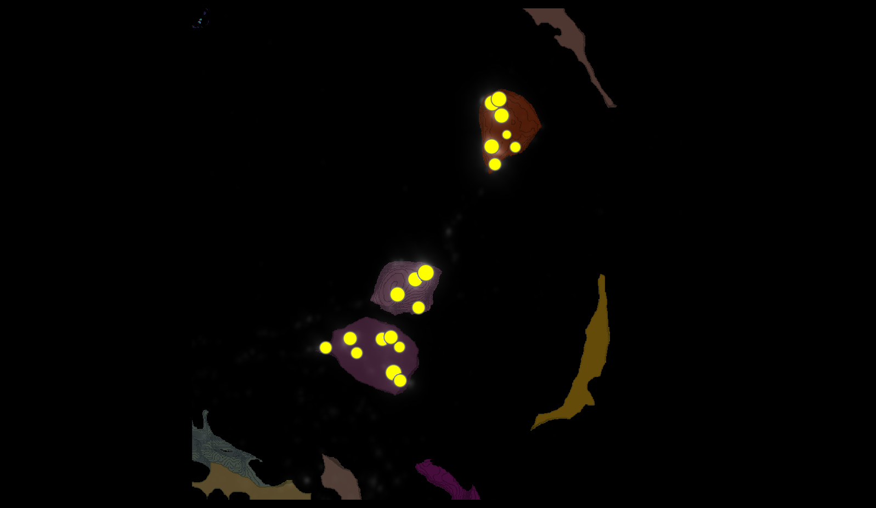
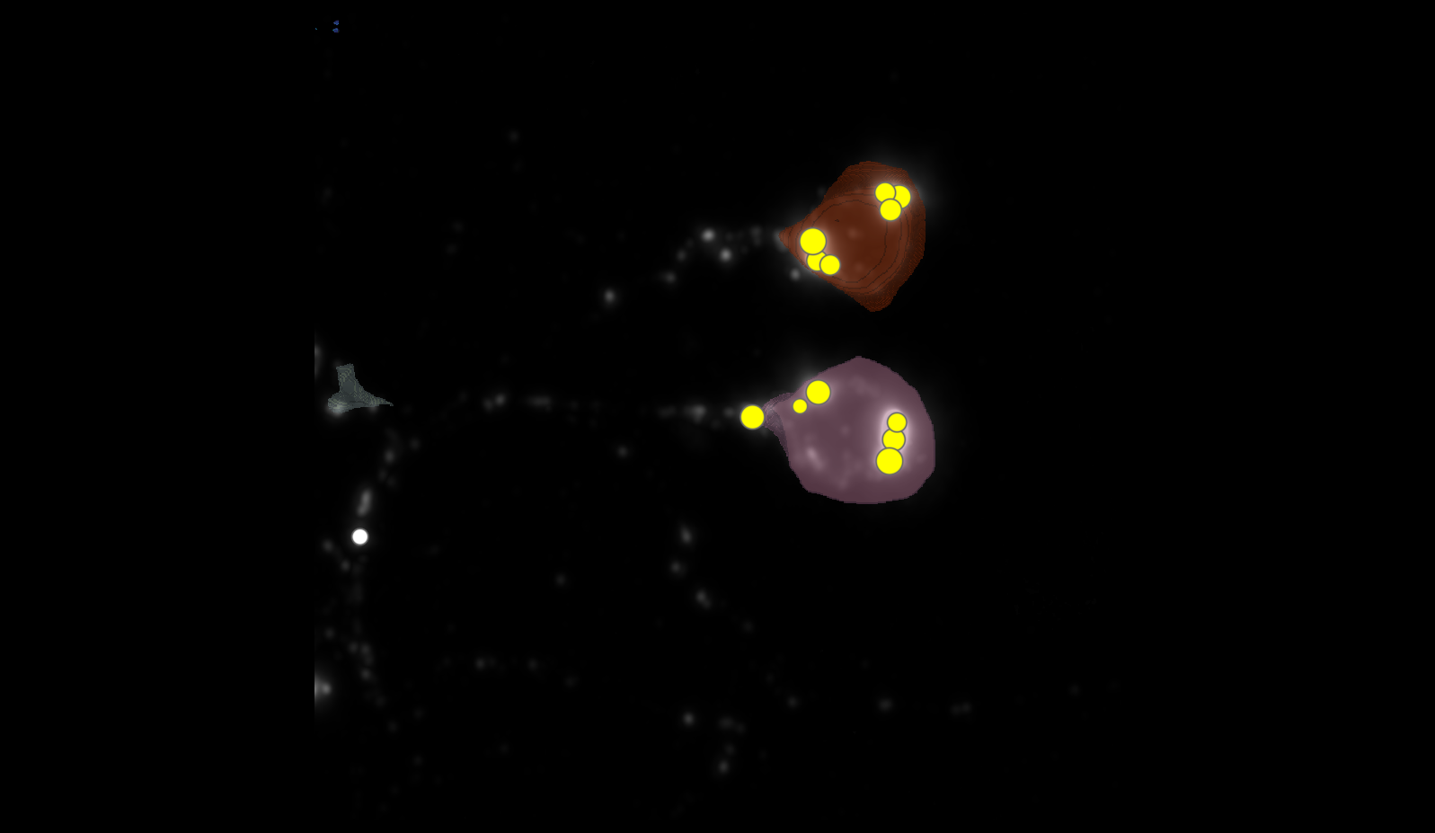
SEGMENTATION
0H 1
0H 2

Slide 11
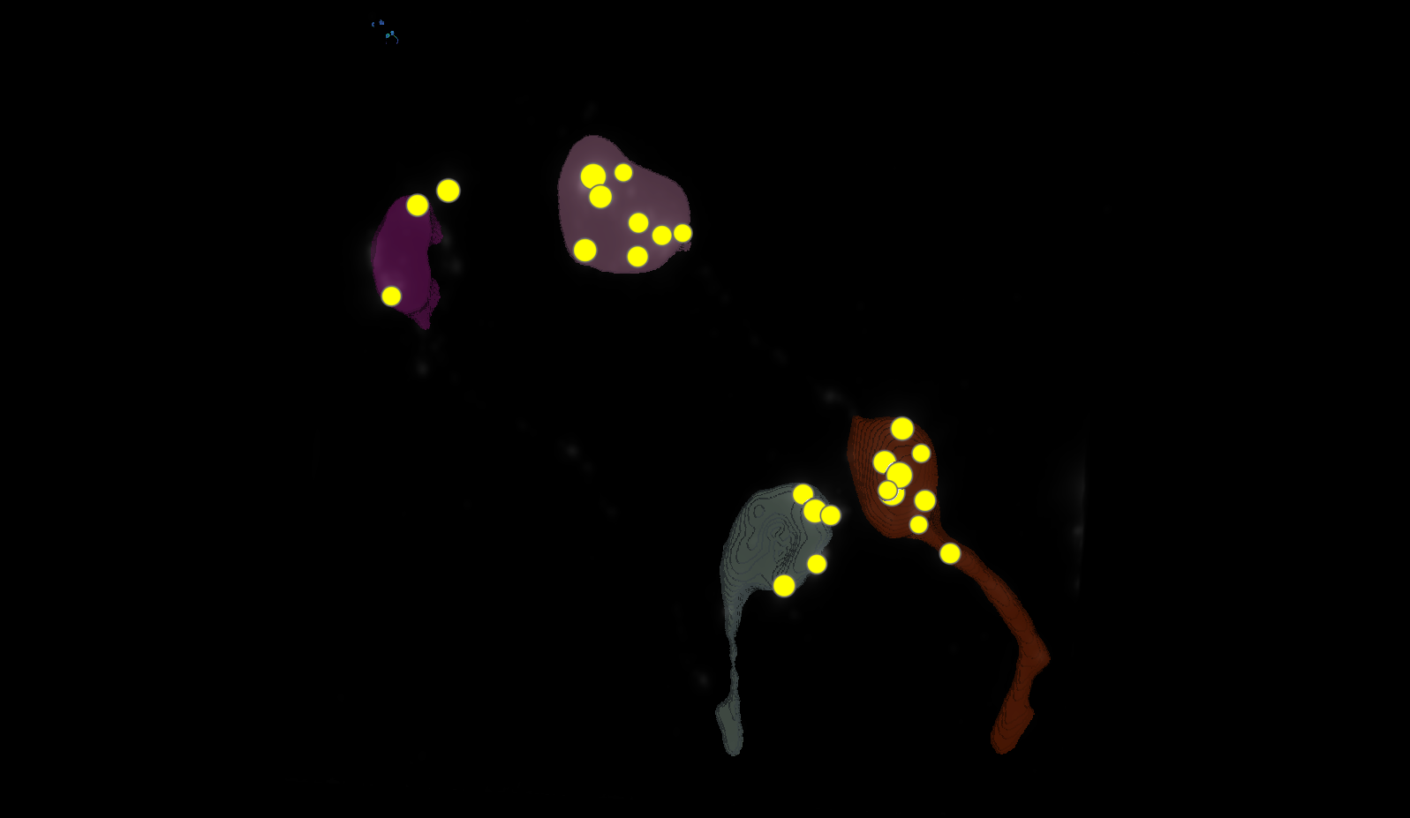
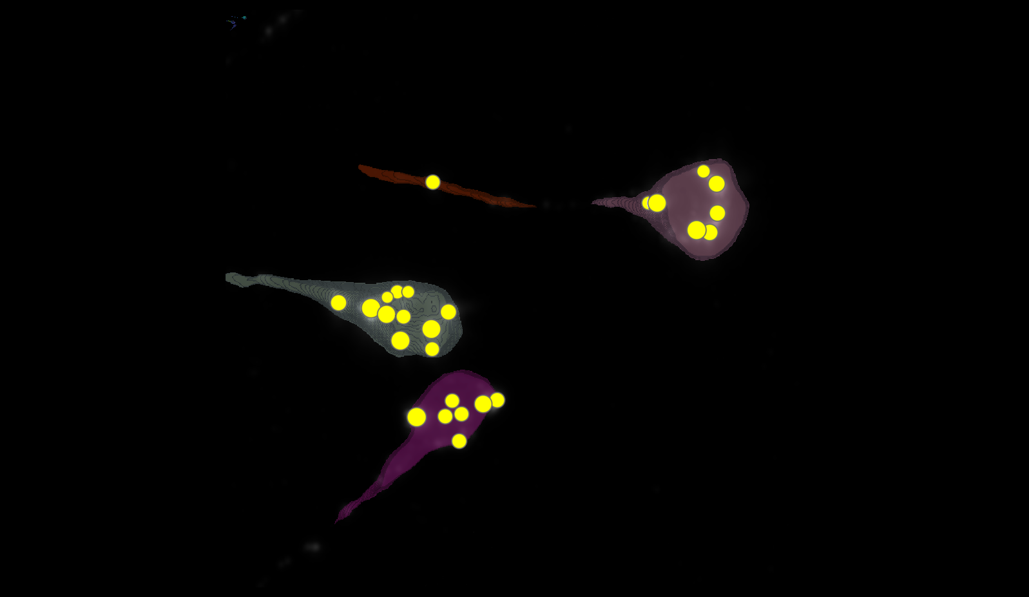
SEGMENTATION
4H 1
4H 2

Slide 12
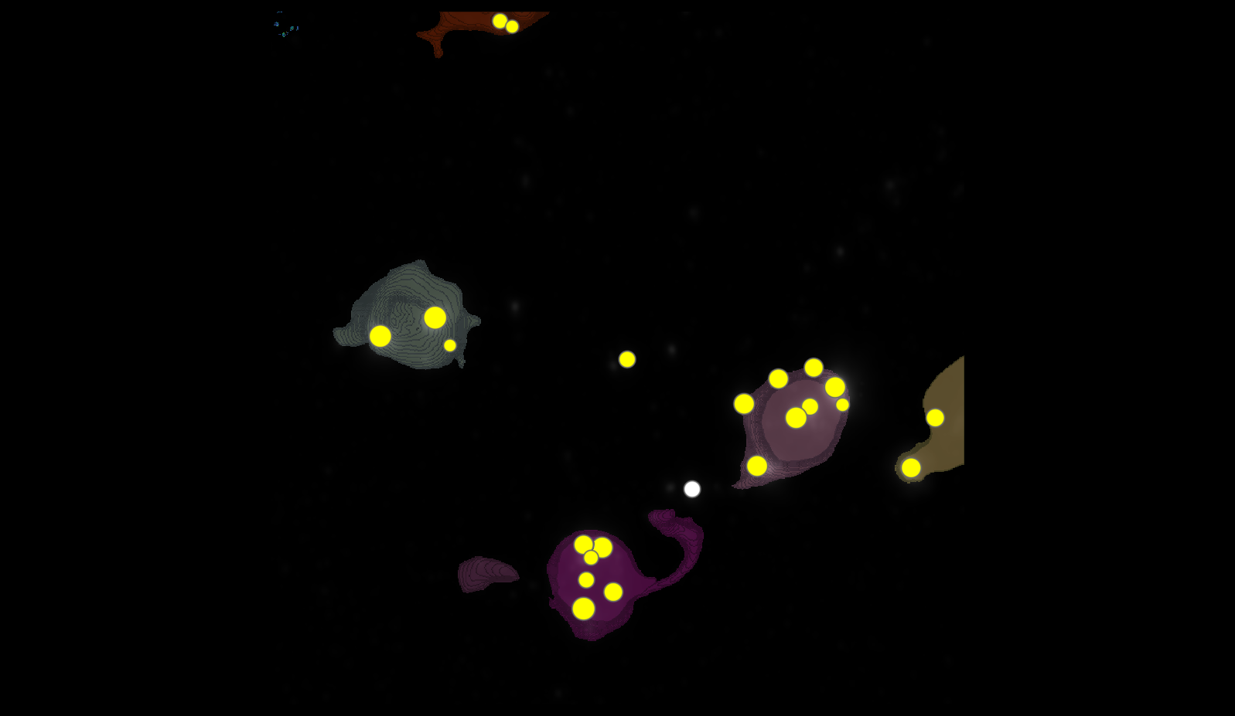
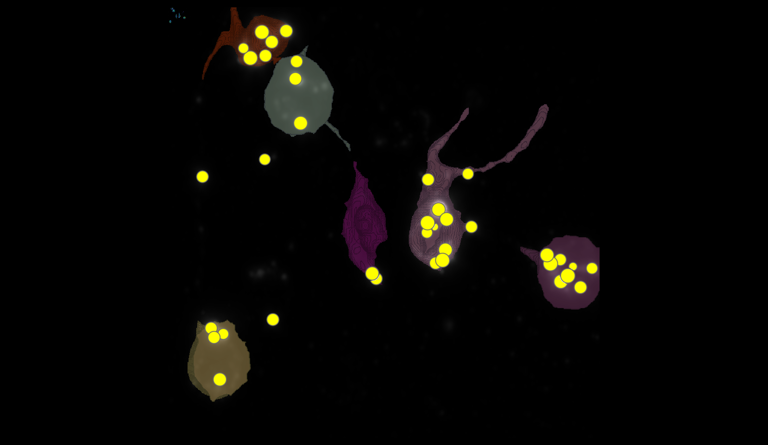
SEGMENTATION
8H 1
8H 2

Slide 13
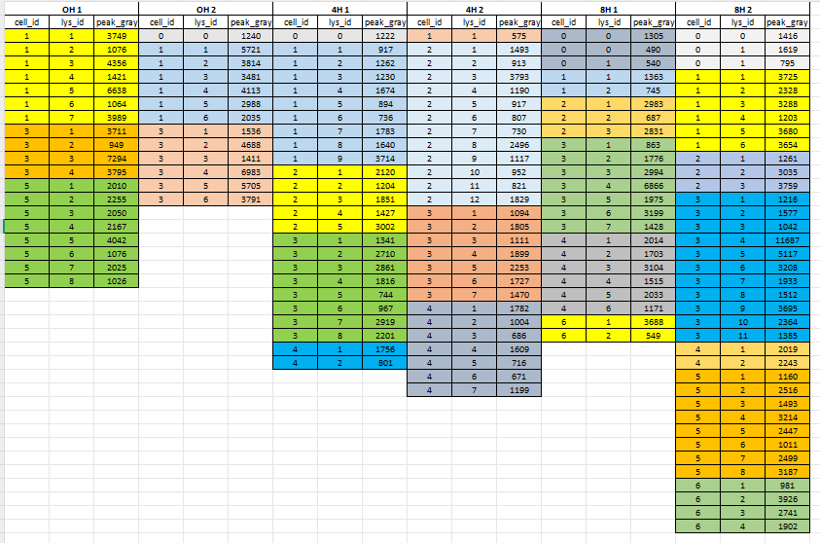
DATASETS

Slide 14
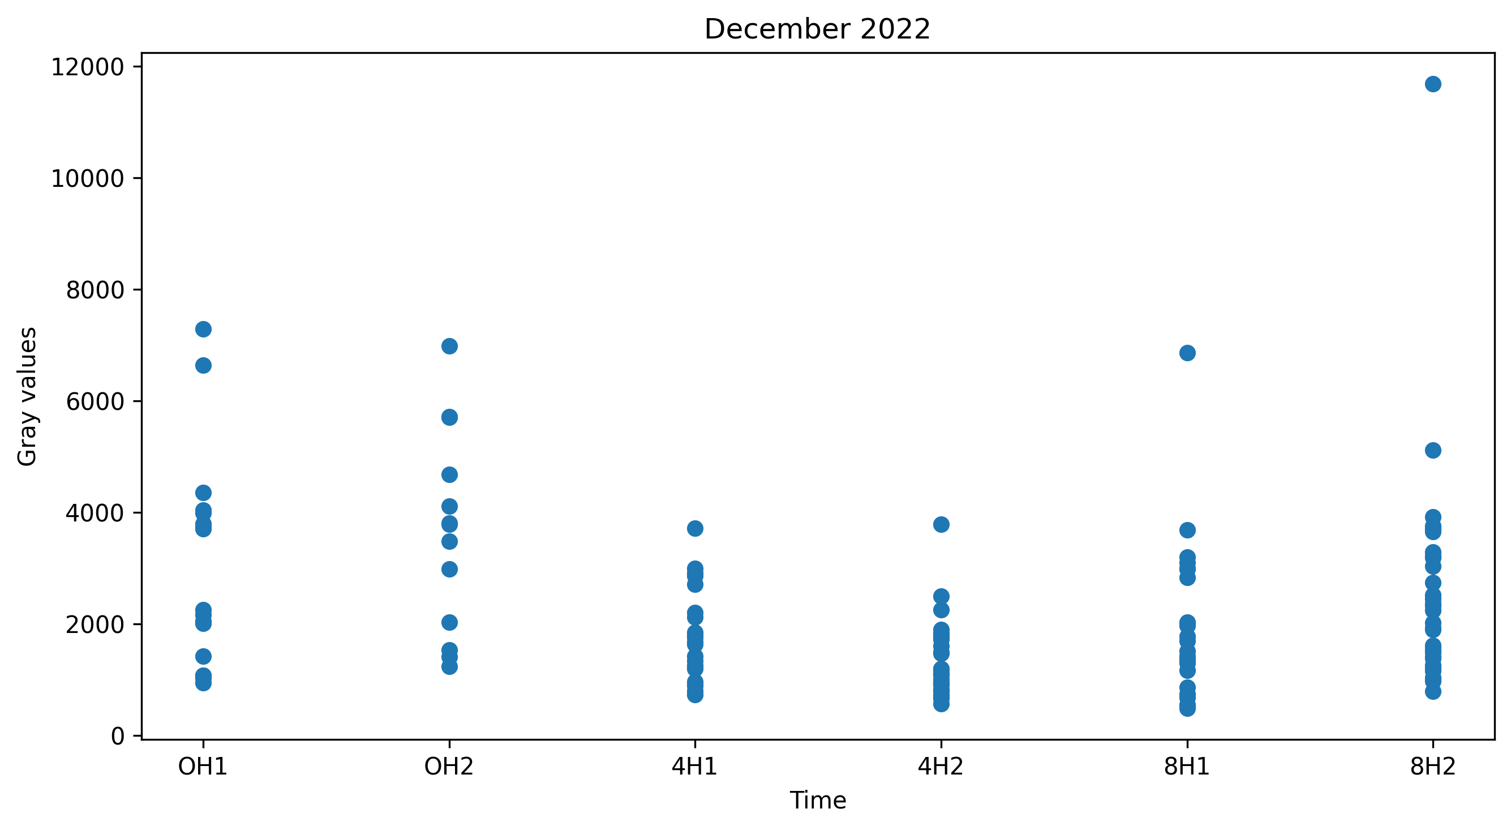
PLOT

Slide 15
JULY 2024

Slide 16
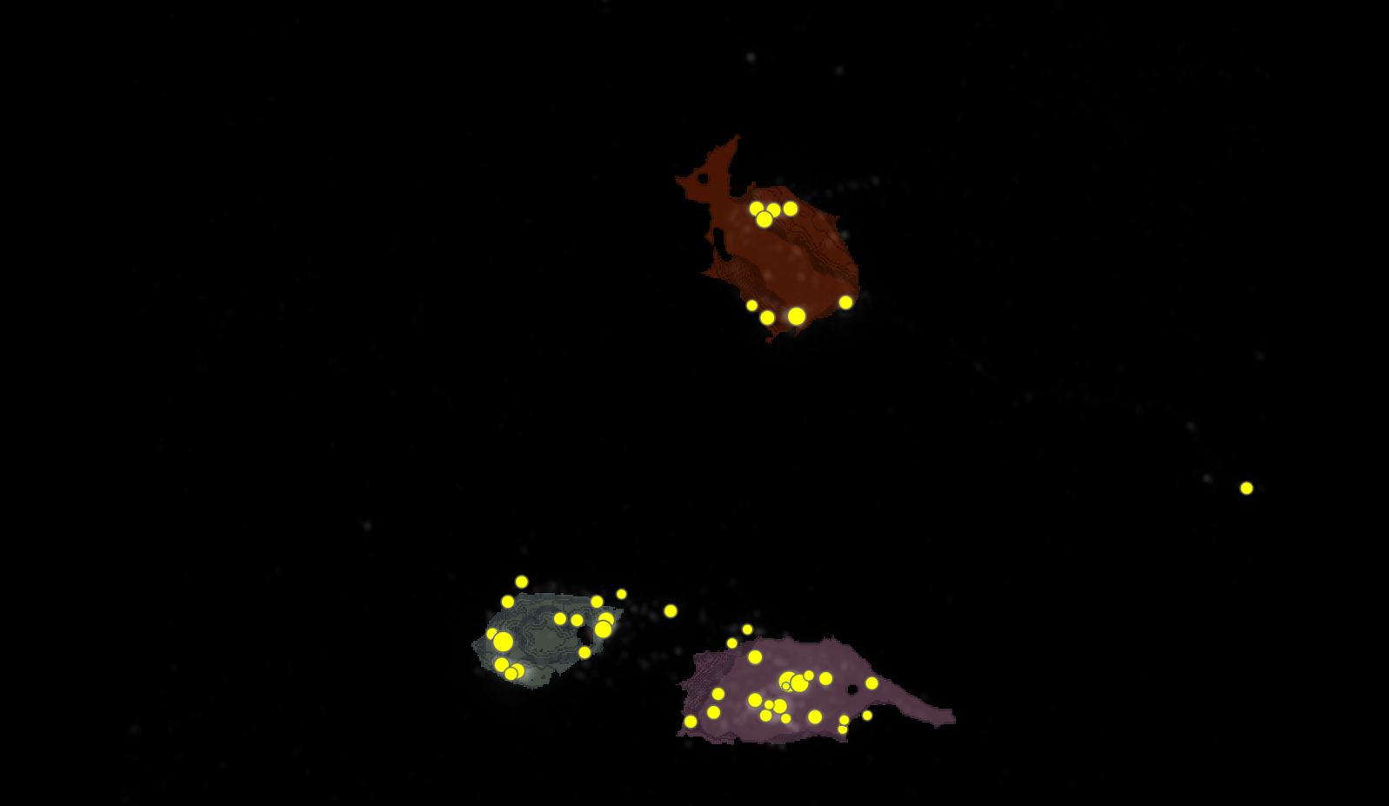
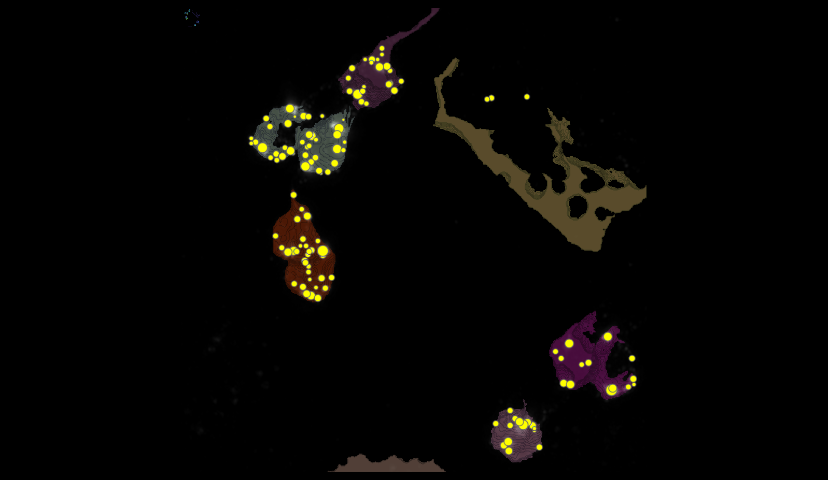
SEGMENTATION
L3 1
L3 2

Slide 17
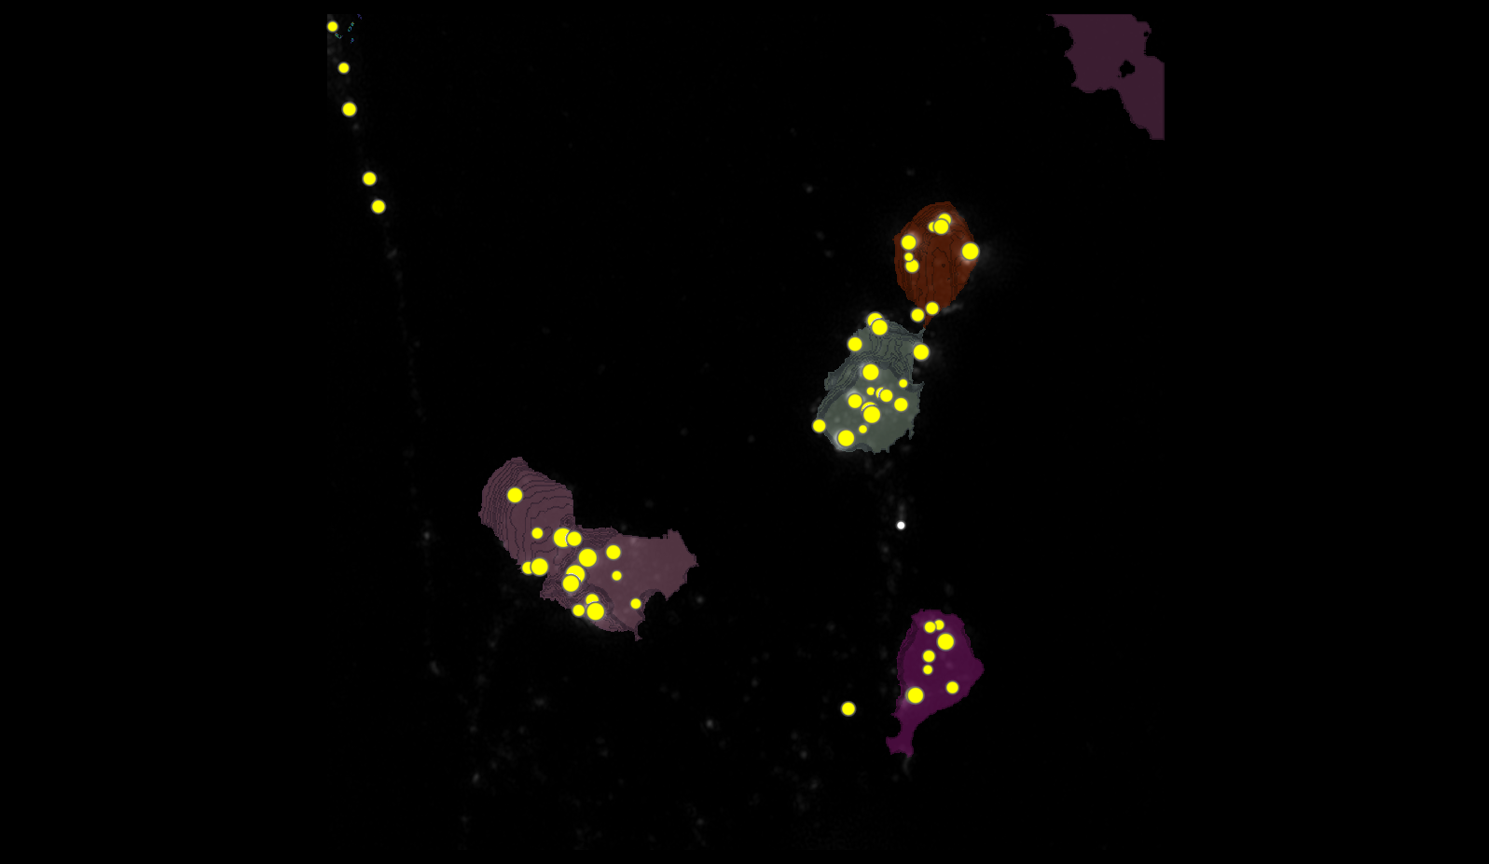
SEGMENTATION
L3 4

Slide 18
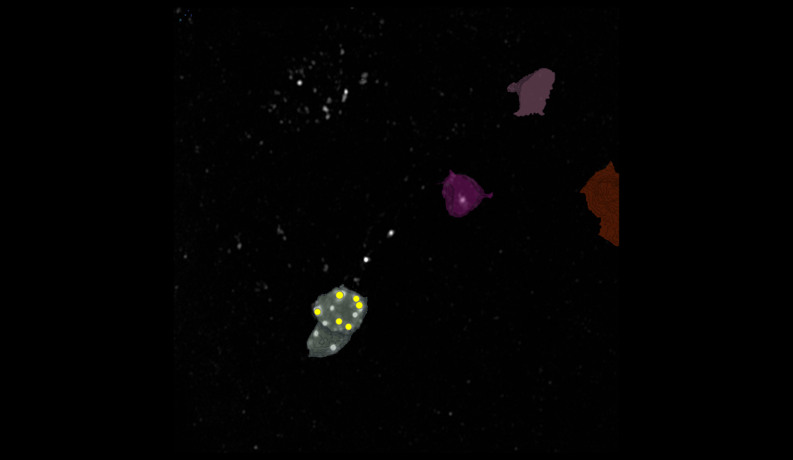
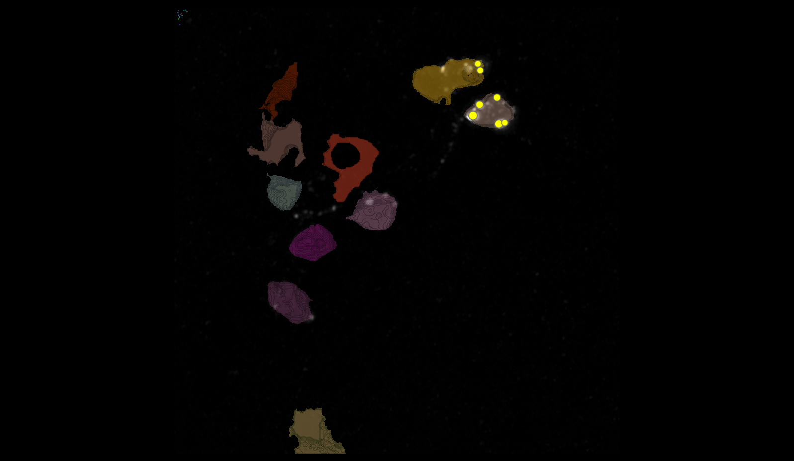
SEGMENTATION
18H 1
18H 4

Slide 19
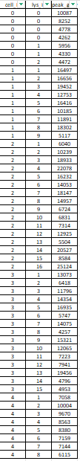
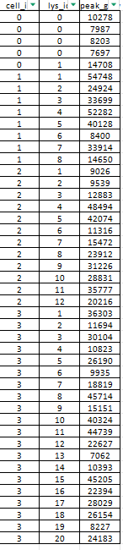
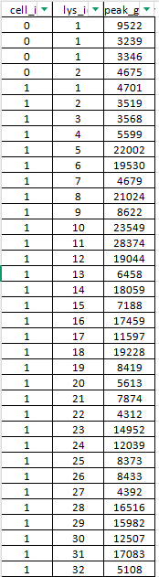
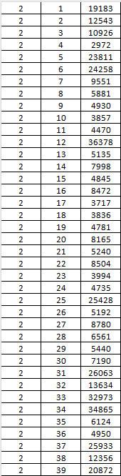
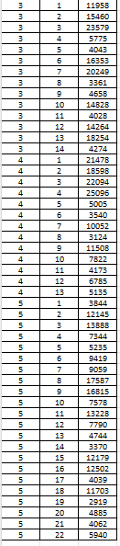
DATASETS L3
L3 2
L3 1
L3 4

Slide 20
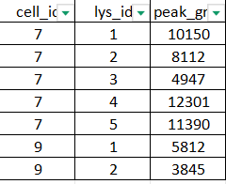
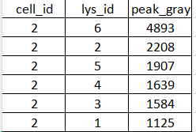
DATASETS 18h
18H 1
18H 4

Slide 21
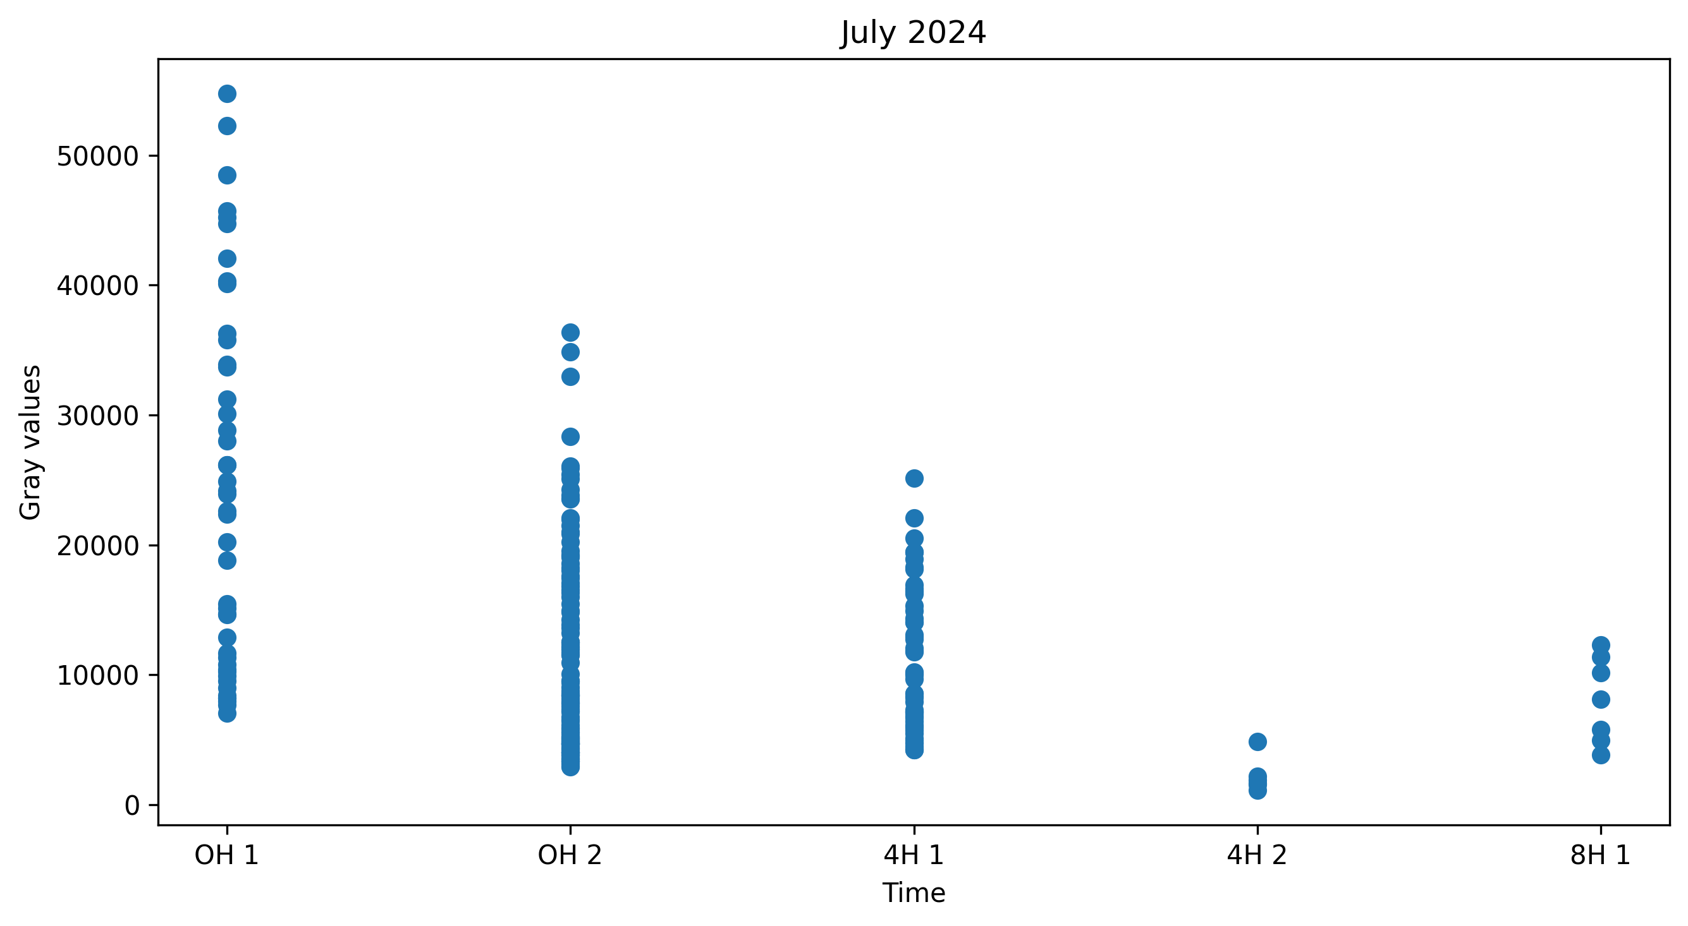
PLOT

